Slide 1
OBJECT ORIENTED DESIGN AND PROGRAMMING
Subject Code: 18CSC202J
UNIT III
By
Mr.K.Senthil Kumar
Asst. Professor
Mr.S.Deepan
Teaching Associate

Slide 2
Topics covered
Feature : Inheritance
Types
Single and Multiple
Multilevel
Hierarchical
Hybrid
Example Programs
UML State Chart Diagram
Example State Chart Diagram
UML Activity Diagram
Example Activity Diagram

Slide 3
INHERITANCE
Inheritance is a mechanism in which one class acquires the property of another class.
For example, a child inherits the traits of his/her parents. With inheritance, we can reuse the fields and methods of the existing class.
Hence, inheritance facilitates Reusability and is an important concept of OOPs

Slide 4
INHERITANCE
Inheritance is one of the key features of Object-oriented programming in C++. It allows user to create a new class (derived class) from an existing class(base class).
The derived class inherits all the features from the base class and can have additional features of its own

Slide 5
Example Program
//Base class
class Parent
{
public:
int id_p;
};
// Sub class inheriting from Base Class(Parent)
class Child : public Parent
{
public:
int id_c;
};
int main()
{
Child obj1;
// An object of class child has all data members and member functions of class parent
obj1.id_c = 7;
obj1.id_p = 91;
cout << "Child id is " << obj1.id_c << endl;
cout << "Parent id is " << obj1.id_p << endl;
return 0;
}

Slide 6
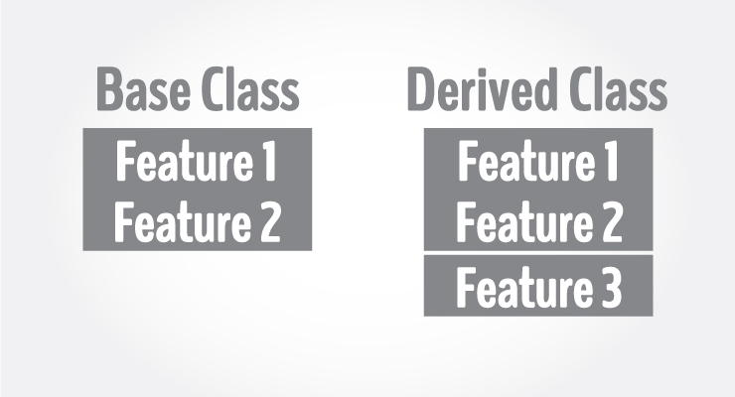
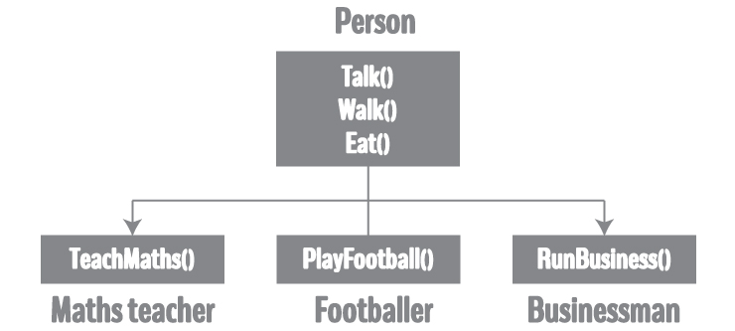
INHERITANCE EXAMPLE

Slide 7
Types of Inheritance
Single Inheritance
Multiple Inheritance
Hierarchical Inheritance
Multilevel Inheritance
Hybrid Inheritance (also known as Virtual Inheritance)

Slide 8
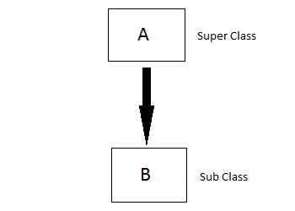
Single Inheritance
In this type of inheritance one derived class inherits from only one base class. It is the most simplest form of Inheritance.

Slide 9
Single Inheritance Syntax
class A //base class
{
..........
};
class B : acess_specifier A // derived class
{
...........
} ;

Slide 10
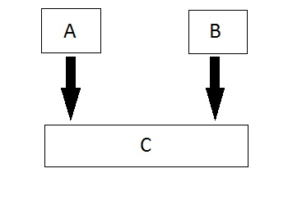
Multiple Inheritance
In this type of inheritance a single derived class may inherit from two or more than two base classes.

Slide 11
Multiple Inheritance Syntax
class A
{
..........
};
class B
{
...........
} ;
class C : acess_specifier A,access_specifier A // derived class from A and B
{
...........
} ;

Slide 12
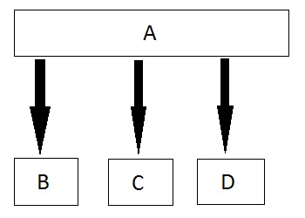
Hierarchical Inheritance
In this type of inheritance, multiple derived classes inherits from a single base class.

Slide 13
Hierarchical Inheritance Syntax
class A // base class
{
..............
};
class B : access_specifier A // derived class from A
{
...........
} ;
class C : access_specifier A // derived class from A
{
...........
} ;
class D : access_specifier A // derived class from A
{
...........
} ;

Slide 14
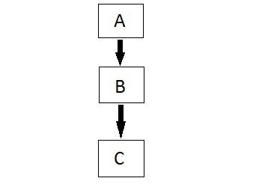
Multilevel Inheritance
In this type of inheritance the derived class inherits from a class, which in turn inherits from some other class. The Super class for one, is sub class for the other.

Slide 15
Multilevel Inheritance Syntax
class A // base class
{
...........
};
class B : acess_specifier A // derived class
{
...........
} ;
class C : access_specifier B // derived from derived class B
{
...........
} ;

Slide 16
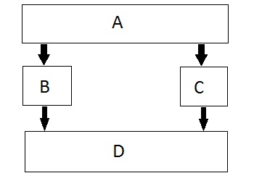
Hybrid (Virtual) Inheritance
Hybrid Inheritance is combination of Hierarchical and Mutilevel Inheritance.

Slide 17
Hybrid Inheritance Syntax
class A
{
.........
};
class B : public A
{
..........
} ;
class C
{
...........
};
class D : public B, public C
{
...........
};

Slide 18
Modes of Inheritance
Public mode: If we derive a sub class from a public base class. Then the public member of the base class will become public in the derived class and protected members of the base class will become protected in derived class.
Protected mode: If we derive a sub class from a Protected base class. Then both public member and protected members of the base class will become protected in derived class.
Private mode: If we derive a sub class from a Private base class. Then both public member and protected members of the base class will become Private in derived class.

Slide 19
Modes of Inheritance
class B : public A
{
// x is public
// y is protected
// z is not accessible from B
};
class C : protected A
{
// x is protected
// y is protected
// z is not accessible from C
};
class D : private A
{
// x is private
// y is private
// z is not accessible from D
};
class A
{
public:
int x;
protected:
int y;
private:
int z;
};

Slide 20
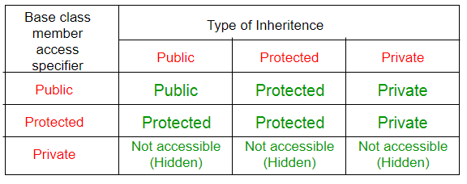
Modes of Inheritance

Slide 21
Advantages of Inheritance
The most frequent use of inheritance is for deriving classes using existing classes, which provides reusability.
The existing classes remain unchanged. By reusability, the development time of software is reduced.

Slide 22
UML : STATE CHART DIAGRAM

Slide 23
Introduction
They define different states of an object during its lifetime.
States are defined as a condition in which an object exists and it changes when some event is triggered
These states are changed by events.
So the most important purpose of State chart diagram is to model life time of an object from creation to termination.
State chart diagrams are useful to model reactive systems
Reactive systems can be defined as a system that responds to external or internal events.
State chart diagram describes the flow of control from one state to another state

Slide 24
Purpose
• Following are the main purposes of using Statechart diagrams:
• To model dynamic aspect of a system.
• To model life time of a reactive system.
• To describe different states of an object during its life time.
• Define a state machine to model states of an object.

Slide 25
How to draw state charts
• Before drawing a Statechart diagram we must
have clarified the following points:
• Identify important objects to be analyzed.
• Identify the states.
• Identify the events

Slide 26
Elements of state chart diagrams
• Initial State: This shows the starting point of the state chart diagram that is where the activity starts.
A filled circle followed by an arrow represents the object's initial state.
Initial State

Slide 27
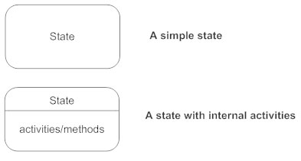
Elements of state chart diagrams
State: A state represents a condition of a modeled entity for which some action is performed. The state is indicated by using a rectangle with rounded corners and contains compartments.

Slide 28
Elements of state chart diagrams
Transition: It is indicated by an arrow. Transition is a relationship between two states which indicates that Event/ Action an object in the first state will enter the second state and performs certain specified actions.
Transition

Slide 29
Elements of state chart diagrams
• Final State: The end of the state chart diagram is represented by a solid circle surrounded by a circle
Final State

Slide 30
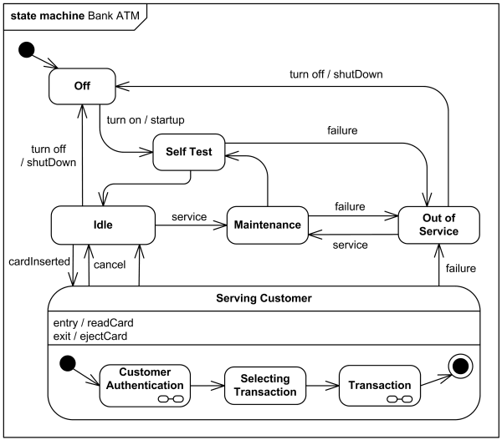
State diagram example: ATM software states at a bank

Slide 31
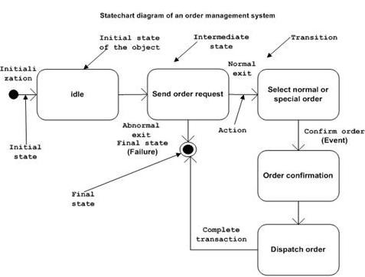
State diagram example: Order management system

Slide 32
When to use Statecharts
The main usages can be described as:
• To model object states of a system.
• To model reactive system. Reactive system
consists of reactive objects.
• To identify events responsible for state
changes.
• Forward and reverse engineering.

Slide 33
UML Activity Diagram

Slide 34
What is an Activity Diagram?
An activity diagram visually presents a series of actions or flow of control in a system similar to a flowchart or a data flow diagram.
Activity diagrams are often used in business process modeling.
They can also describe the steps in a use case diagram. Activities modeled can be sequential and concurrent.
In both cases an activity diagram will have a beginning (an initial state) and an end (a final state).

Slide 35
Activity Diagram Notations and Symbols
Types of symbols
Initial State or Start Point
Activity or Action State
Action Flow
Object Flow
Decisions and Branching
Guards
Synchronization
Time Event
Merge Event
Sent and Received Signals
Interrupting Edge
Final State or End Point
Swimlanes

Slide 36

Activity Diagram Notations and Symbols
Initial State or Start Point
A small filled circle followed by an arrow represents the initial action state or the start point for any activity diagram.
For activity diagram using swimlanes, make sure the start point is placed in the top left corner of the first column.

Slide 37
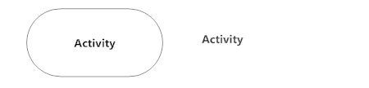
Activity Diagram Notations and Symbols
Activity or Action State
An action state represents the non-interruptible action of objects.
You can draw an action state in SmartDraw using a rectangle with rounded corners.

Slide 38

Activity Diagram Notations and Symbols
Action Flow
Action flows, also called edges and paths, illustrate the transitions from one action state to another. They are usually drawn with an arrowed line.

Slide 39
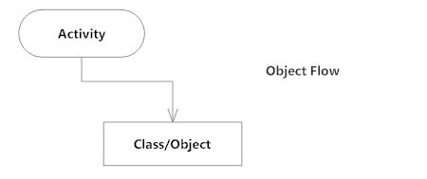
Activity Diagram Notations and Symbols
Object Flow
Object flow refers to the creation and modification of objects by activities. An object flow arrow from an action to an object means that the action creates or influences the object.
An object flow arrow from an object to an action indicates that the action state uses the object.

Slide 40

Activity Diagram Notations and Symbols
Decisions and Branching
A diamond represents a decision with alternate paths. When an activity requires a decision prior to moving on to the next activity, add a diamond between the two activities.
The outgoing alternates should be labeled with a condition or guard expression. You can also label one of the paths "else."

Slide 41
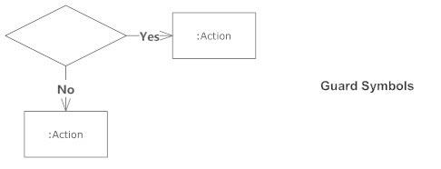
Activity Diagram Notations and Symbols
Guards
In UML, guards are a statement written next to a decision diamond that must be true before moving next to the next activity. These are not essential, but are useful when a specific answer, such as "Yes, three labels are printed," is needed before moving forward.

Slide 42
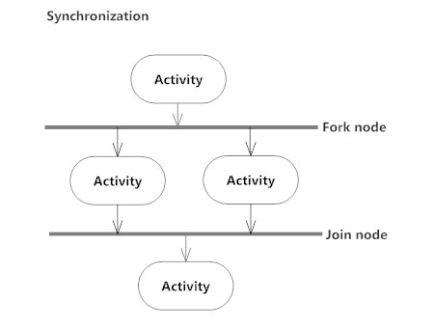
Activity Diagram Notations and Symbols
Synchronization
A fork node is used to split a single incoming flow into multiple concurrent flows. It is represented as a straight, slightly thicker line in an activity diagram.
A join node joins multiple concurrent flows back into a single outgoing flow.
A fork and join mode used together are often referred to as synchronization.

Slide 43
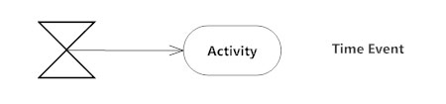
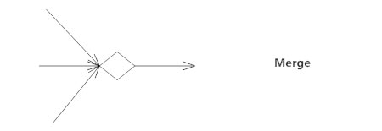
Activity Diagram Notations and Symbols
Time Event
This refers to an event that stops the flow for a time; an hourglass depicts it.
Merge Event
A merge event brings together multiple flows that are not concurrent.

Slide 44
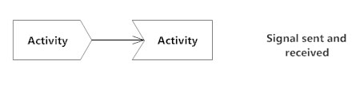
Activity Diagram Notations and Symbols
Sent and Received Signals
Signals represent how activities can be modified from outside the system.
They usually appear in pairs of sent and received signals, because the state can't change until a response is received, much like synchronous messages in a sequence diagram. For example, an authorization of payment is needed before an order can be completed.

Slide 45
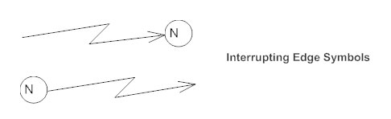
Activity Diagram Notations and Symbols
Interrupting Edge
An event, such as a cancellation, that interrupts the flow denoted with a lightning bolt.

Slide 46

Activity Diagram Notations and Symbols
Final State or End Point
An arrow pointing to a filled circle nested inside another circle represents the final action state.

Slide 47
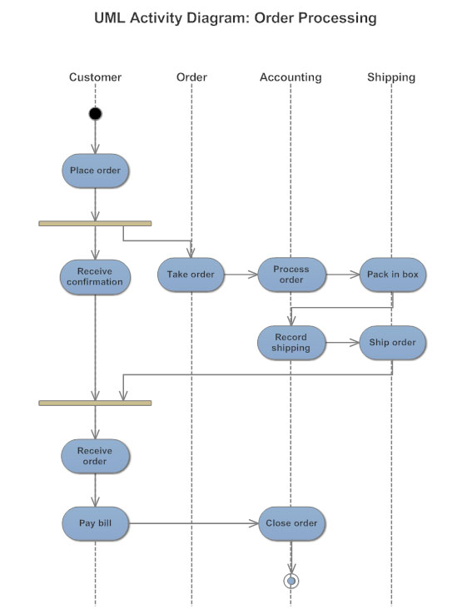
Activity Diagram Notations and Symbols
Swimlanes
Swimlanes group related activities into one column.

Slide 48
How to Draw an activity diagram
Identify the initial state and the final states.
Identify the intermediate activities needed to reach the final state from he initial state.
Identify the conditions or constraints which cause the system to change control flow.
Draw the diagram with appropriate notations.

Slide 49
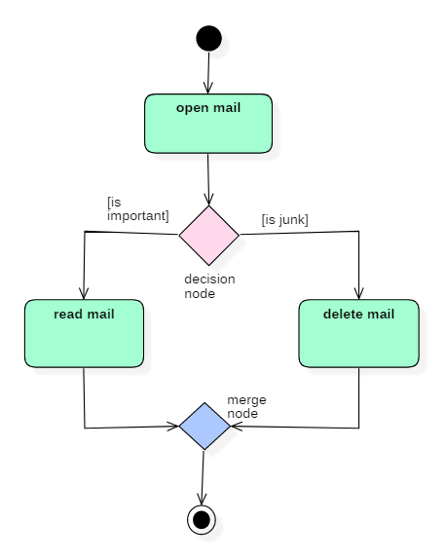
Example of Activity Diagram
Let us consider mail processing activity as a sample for Activity Diagram. Following diagram represents activity for processing e-mails.

Slide 50
Uses of an Activity Diagram
Dynamic modelling of the system or a process.
Illustrate the various steps involved in a UML use case.
Model software elements like methods , operations and functions.
We can use Activity diagrams to depict concurrent activities easily.
Show the constraints, conditions and logic behind algorithms.

Slide 51
Thank you

